Slide 2

Prepared by:
Team foodtrip

Slide 3
Members
Jimmy Tan (Leader)
Rouzzandra Zuñiga
Iñigo Marquez
Andrepov Felix

Slide 4
Name of Project
Background
Food Trip is a web and mobile-based application wherein
all kinds of restaurants are involved and will be pioneered globally.
Having their digital profile endorsed, enhanced, and easily
searched for the convenience of quality food-craving
consumers.

Slide 5
Target Client
Information Suppliers
Restaurant Managers
Updates the database of his/her restaurant through the use of the website and mobile application
Consumers
Food bloggers
Food leisure seekers
All individuals

Slide 6
Problem Statement
The rise of fastfood chains and mediocre restaurants in our country nowadays are having a rapid growth of attention and reputation and thus, luxurious cuisines are having difficulty in coping up with the level of their competitor’s growth in both attention and reputation.
On the other hand, food enthusiasts are experiencing boredom with continuously feasting through fastfoods and mediocre restaurants because they would have no easy means of locating luxurious cuisines.
Food enthusiasts do often hesitate in trying out luxurious cuisines due to lack of specific details about it.

Slide 7
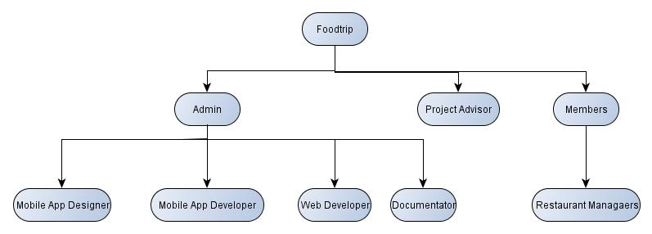
Organizational Chart

Slide 8
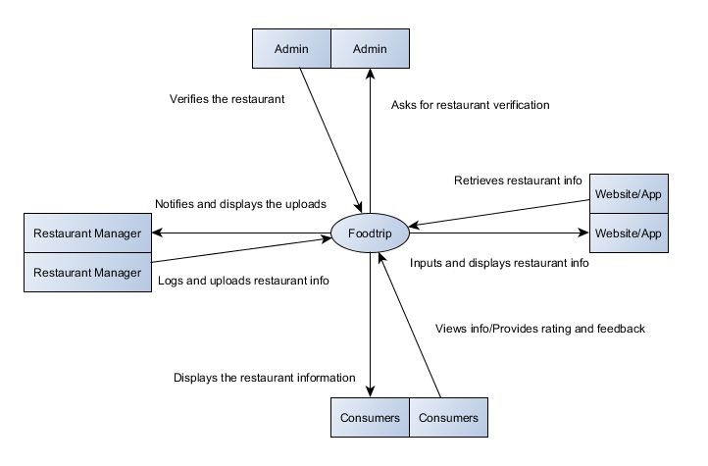
Context Level Diagram

Slide 9
Data Flow Diagram

Slide 10
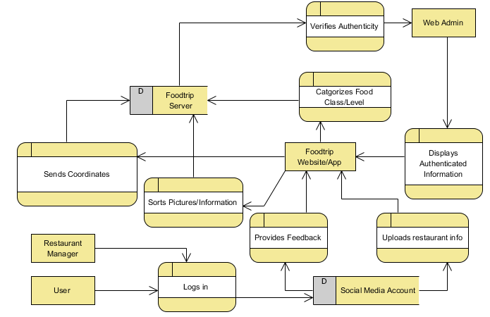

Slide 11
Entity Relationship Diagram

Slide 12
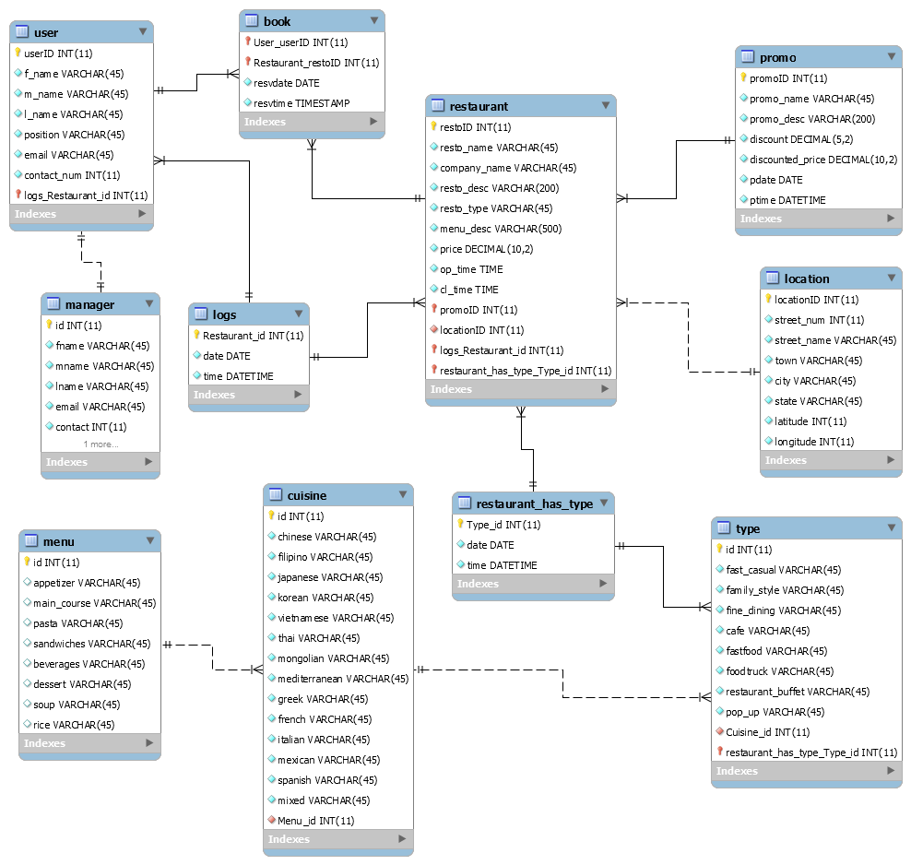

Slide 13
Data Table
DATA TYPE | DATA ELEMENT | DESCRIPTION
INT | Id | Primary Keys for all tables
VARCHAR(45) | f/l/m_name | Attribute for Users and Restaurant Managers
VARCHAR(45) | Position | Attribute for either working or student or n/a
DATETIME | time | Attribute for recording the time the event has been processed
DATETIME | date | Attribute for recording the date the event has been processed
VARCHAR(45) | resvdate | Attribute for identifying the type of entity
 | resvtime

